Slide 1

VEHICLE ACCIDENT PREVENTION SYSTEM

Slide 2
WHAT IS IT?
COLLISION WARNING SYSTEM
EMERGENCY BROADCASTER
SOCIAL NETWORKING TOOL

Slide 3
COLLISION PREVENTION SYSTEM
Let’s begin with this module

Slide 4
HOW DOES IT FUNCTION
There are two aspects of the main collision prevention system: the sensor network and the mobile application
THE SENSORS
Works on a network of sensors that detect nearby objects
4 such sensor relays located within the vehicle
Each connected to main coordinator module
Coordinator calculates distances using sensor data, relays it back to the phone application
THE APPLICATION
The application will
display a top-down perspective of the vehicle
has color based indications of how far away objects are from the vehicle’s exterior

Slide 5
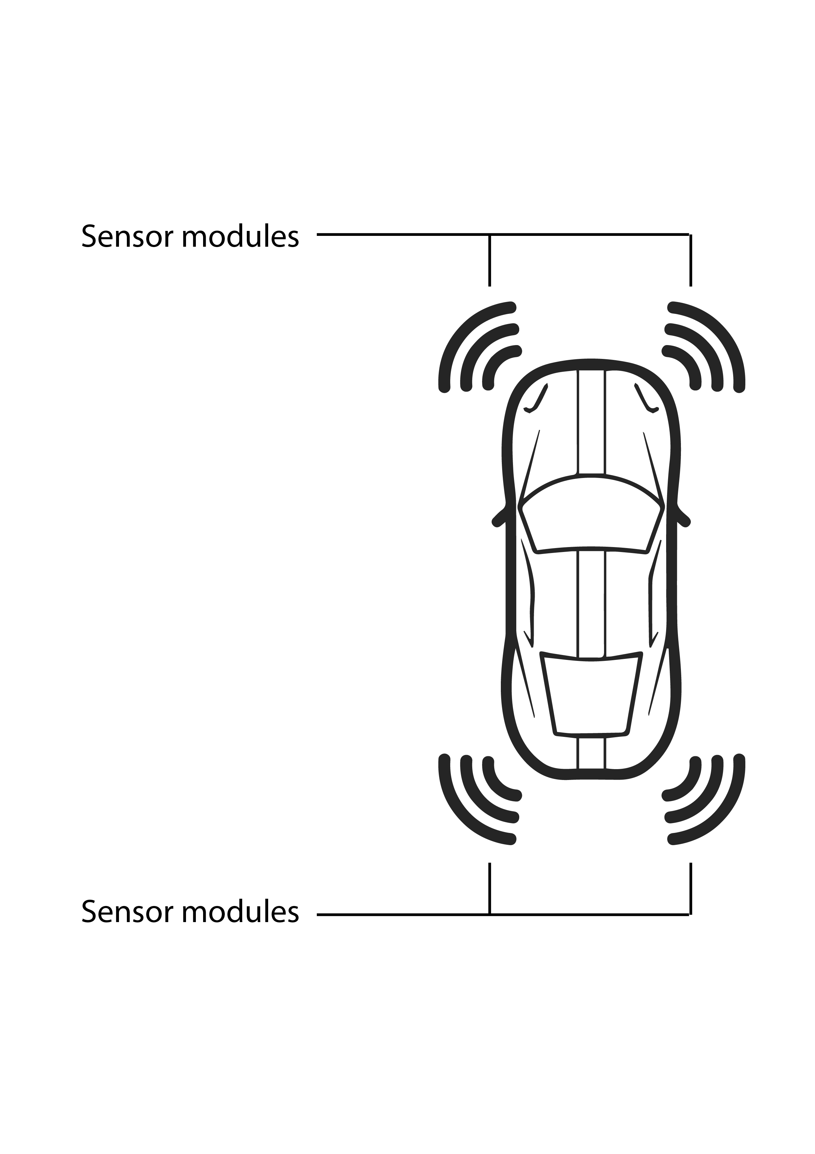
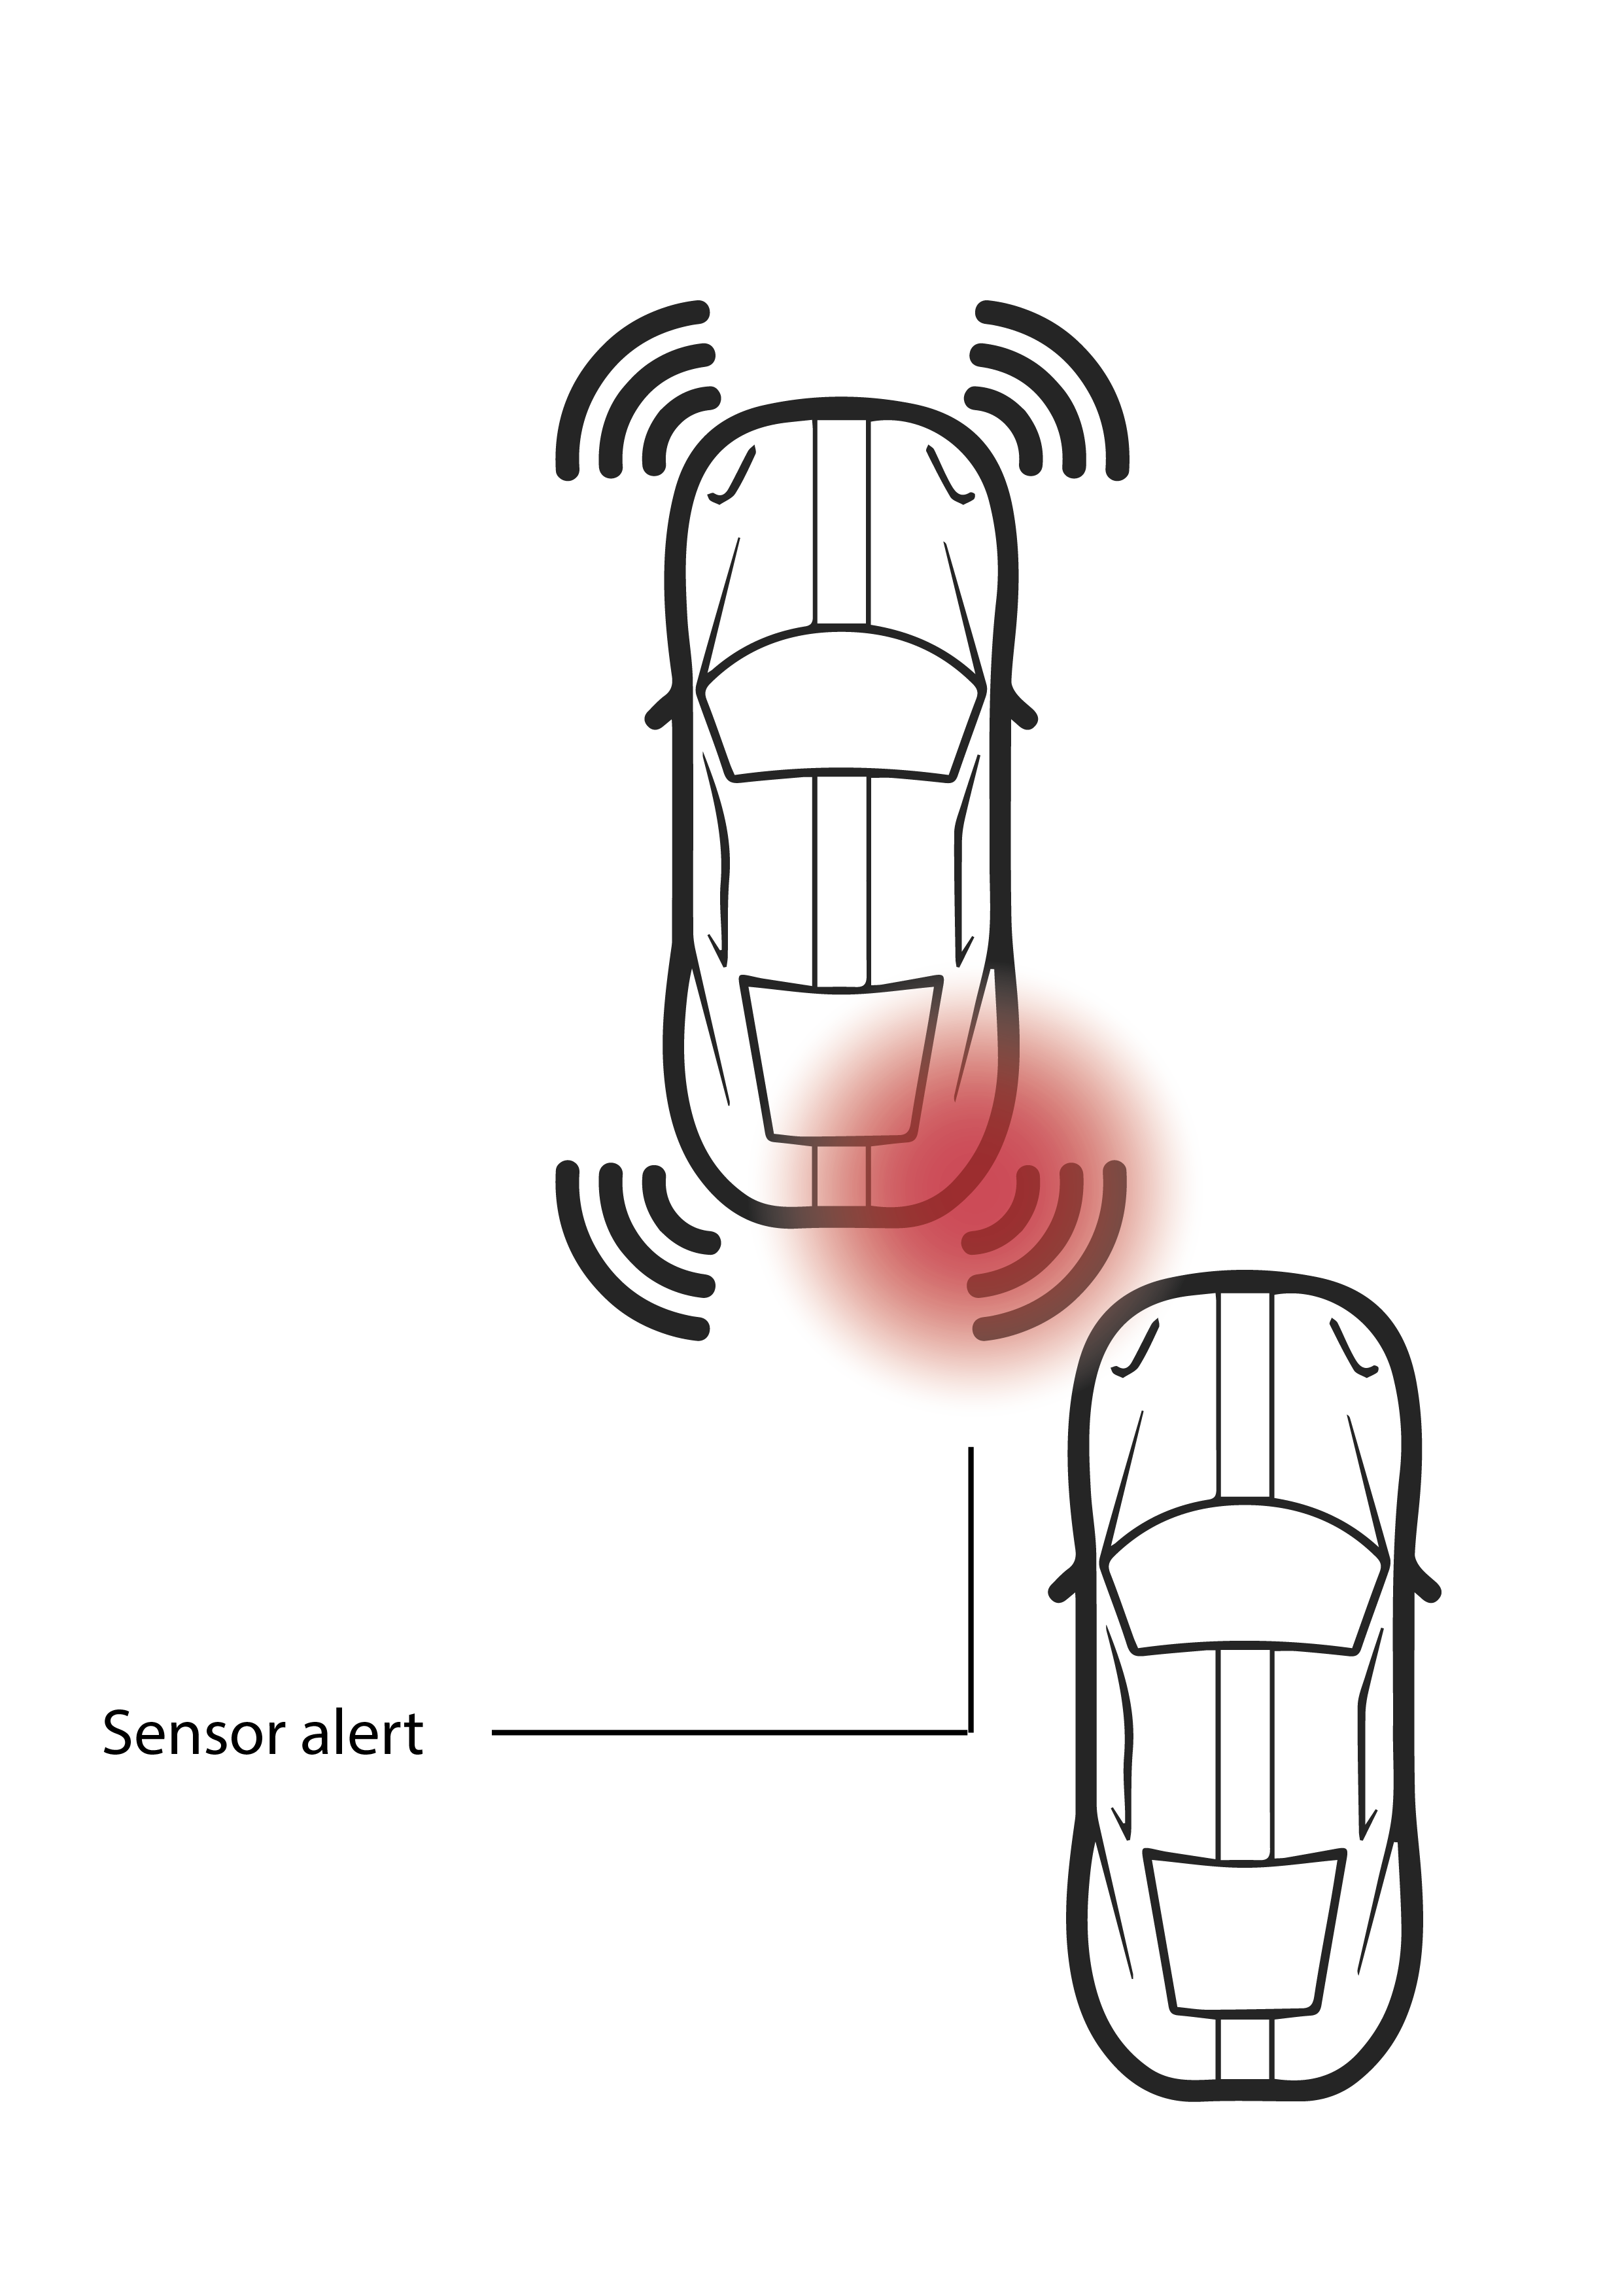
Normal Functioning
Potential Incident

Slide 6
EMERGENCY BROADCASTER
This module is a personal feature within the application

Slide 7
The user enters up to 3 emergency contacts
In the event of an accident, an alarm begins counting down on the app
If it is not disabled in time, an SMS is sent to the emergency contacts relaying the time and location of the accident

Slide 8



SOCIAL NETWORKING
This aspect is a likely future addition to the system

Slide 9
WHAT ARE ITS FEATURES
We plan to add a media capture system, with a camera within each node module. These cameras together will create a panoramic view from the vehicle’s perspective, which we call a sphere. Users will be able to upload their spheres to social media sites such as Instagram, Facebook, Twitter, etc. with an inbuilt geo-tagging feature within the mobile application.
Users can also take photos & videos from single cameras and upload them.

Slide 10
The Team
Prashanth Putta
Tarang Gupta
Ankit Khadore
Sarat Rallabandi
Nihal Vidyala
Srikanta Raju
Varun Rajeev

Slide 11

Thanks!!
Any questions?
You can contact us at

